Slide 1
Computer Security
Tuan M. Nguyen & Van K. Nguyen
Database Security

Slide 2
Content
Introduction to Databases
Security Requirements
Database Security Levels
Reliability and Integrity
Attacks against database

Slide 3
Introduction to Databases
Database – collection of data and set of rules that organize the data by specifying certain relationships among the data.
Database administrator (DBA)
Database management system (DBMS) – database manager
Notes:
A database is a collection of data and a set of rules that organize the data by specifying certain relationships among the data. Through these rules, the user describes a logical format for the data. The data items are stored in a file, but the precise physical format of the file is of no concern to the user.
A database administrator is a person who defines the rules that organize the data and also controls who should have access to what parts of the data.
The user interacts with the database through a program called a database manager or a database management system (DBMS),

Slide 4
Introduction to Databases
Records – contain related group of data
Fields – elementary data items
Schema – logical structure of database
Subschema – view into database
Name | First | Address | City | State | Zip | Airport
ADAMS | Charles | 212 Market St. | Columbus | OH | 43210 | CMH
BENCHLY | Zeke | 501 Union St. | Chicago | IL | 60603 | ORD
CARTER | Marlene | 411 Elm St. | Columbus | OH | 43210 | CMH
Notes:
The database file consists of records, each of which contains one related group of data
Each record contains fields or elements, the elementary data items themselves
The logical structure of a database is called a schema. A particular user may have access to only part of the database, called a subschema
The fields in the name and address record are NAME, ADDRESS, CITY, STATE, and ZIP
This database can be viewed as a two-dimensional table, where a record is a row and each field of a record is an element of the table

Slide 5
Introduction to Databases
Queries
  Commands that retrieve, modify, add, or delete fields and records of the database
  Most query languages are based on SQL, a structured query language.
  SELECT NAME = ‘ADAMS’
  SELECT (ZIP = ‘43210’) ^ (NAME = ‘ADAMS’)
Notes:
Users interact with database managers through commands to the DBMS that retrieve, modify, add, or delete fields and records of the database. A command is called a query.
Database management systems have precise rules of syntax for queries. Most query languages use an English-like notation, and many are based on SQL, a structured query language originally developed by IBM.

Slide 6
Introduction to Databases
Advantages of Using Databases
  Shared access
  Minimal redundancy
  Data consistency
  Data integrity
  Controlled access
Notes:
Shared access, so that many users can use one common, centralized set of data
Minimal redundancy, so that individual users do not have to collect and maintain their own sets of data
Data consistency, so that a change to a data value affects all users of the data value
Data integrity, so that data values are protected against accidental or malicious undesirable changes
Controlled access, so that only authorized users are allowed to view or to modify data values

Slide 7
Security Requirements
Physical database integrity
Logical database integrity
Element integrity
Auditability
Access control
User authentication
Availability
Notes:
Physical database integrity. The data of a database are immune to physical problems, such as power failures, and someone can reconstruct the database if it is destroyed through a catastrophe.
Logical database integrity. The structure of the database is preserved. With logical integrity of a database, a modification to the value of one field does not affect other fields, for example.
Element integrity. The data contained in each element are accurate.
Auditability. It is possible to track who or what has accessed (or modified) the elements in the database.
Access control. A user is allowed to access only authorized data, and different users can be restricted to different modes of access (such as read or write).
User authentication. Every user is positively identified, both for the audit trail and for permission to access certain data.
Availability. Users can access the database in general and all the data for which they are authorized.

Slide 8
Security Requirements
Integrity of the Database
  Users must be able to trust the accuracy of the data values
  Updates are performed by authorized individuals
  Integrity is the responsibility of the DBMS, the OS, and the computing system manager
  Must be able to reconstruct the database at the point of a failure
Notes:
If a database is to serve as a central repository of data, users must be able to trust the accuracy of the data values. This condition implies that the database administrator must be assured that updates are performed only by authorized individuals. It also implies that the data must be protected from corruption, either by an outside illegal program action or by an outside force such as fire or a power failure.
Integrity of the database as a whole is the responsibility of the DBMS, the operating system, and the (human) computing system manager.
Sometimes it is important to be able to reconstruct the database at the point of a failure. For instance, when the power fails suddenly, a bank's clients may be in the middle of making transactions or students may be in the midst of registering online for their classes.

Slide 9
Security Requirements
Element Integrity
  Correctness or accuracy of elements
  Field checks
  Access control
  Maintain a change log – list every change made to the database
Notes:
Correctness or accuracy of elements
Field checks
Access control
Maintain a change log – list every change made to the database

Slide 10
Security Requirements
Auditability & Access Control
  Desirable to generate an audit record of all access to the database (reads/writes)
  Pass-through problem – accessing a record or element without transferring the data received to the user (no reads/writes)
  Databases separated logically by user access privileges
Notes:
Desirable to generate an audit record of all access to the database (reads/writes)
Pass-through problem – accessing a record or element without transferring the data received to the user (no reads/writes)
Databases separated logically by user access privileges

Slide 11
Security Requirements
Other Security Requirements
  User Authentication
  Confidentiality
  Availability
Notes:
User Authentication: The DBMS can require rigorous user authentication. For example, a DBMS might insist that a user pass both specific password and time-of-day checks
Availability, Confidentiality: The three aspects of computer securityintegrity, confidentiality, and availabilityclearly relate to database management systems. As we have described, integrity applies to the individual elements of a database as well as to the database as a whole.

Slide 12
Database Security Levels
Relational database: collection of related
data files
Data file: collection of related tables
Table: collection of related rows (records)
Row: collection of related columns (fields)
Notes:
Relational database: collection of related data files
Data file: collection of related tables
Table: collection of related rows (records)
Row: collection of related columns (fields)

Slide 13
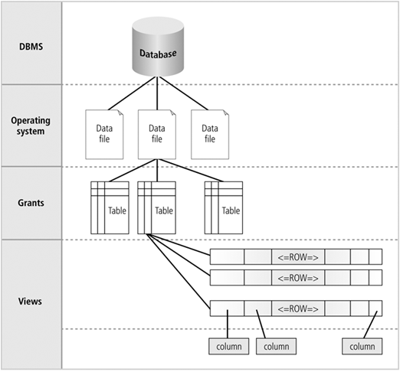
Database Security Levels

Slide 14
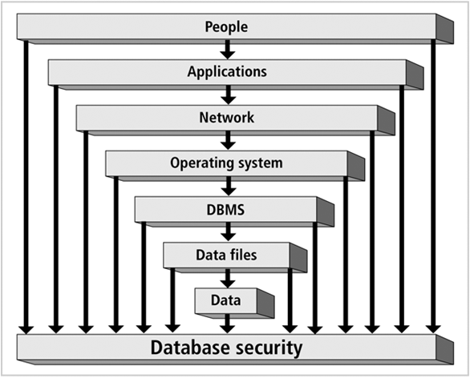
Menaces to Databases
Security access point: place where database security must be protected and applied
Notes:
Security gaps: points at which security is missing
Vulnerabilities: kinks in the system that can become threats
Threat: security risk that can become a system breach

Slide 15
Menaces to Databases
Security gaps: points at which security is missing
Vulnerabilities: kinks in the system that can become threats
Threat: security risk that can become a system breach
Notes:
Security gaps: points at which security is missing
Vulnerabilities: kinks in the system that can become threats
Threat: security risk that can become a system breach

Slide 16
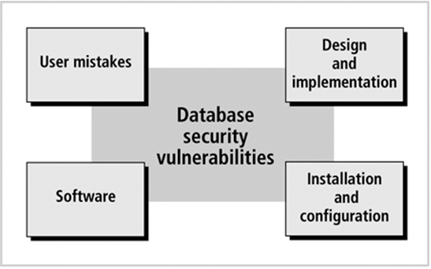
Menaces to Databases
Security vulnerability: a weakness in any information system component
Notes:
Security vulnerability: user, software, design, config

Slide 17
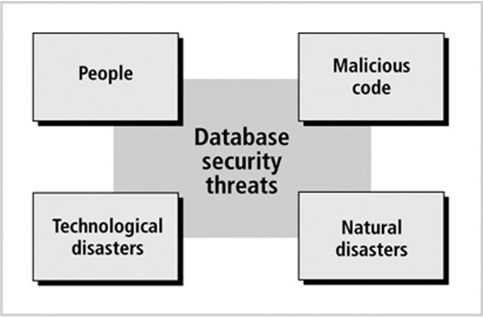
Menaces to Databases
Security threat: a security violation or attack that can happen any time because of a security vulnerability
Notes:
Security vulnerability: user, software, design, config

Slide 18
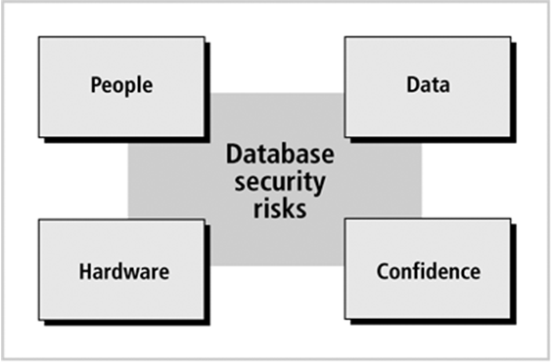
Menaces to Databases
Security risk: a known security gap intentionally left open
Notes:
Security vulnerability: user, software, design, config

Slide 19
Reliability and Integrity
Database concerns
  Database integrity
  Element integrity
  Element accuracy
Some protection from OS
  File access
  Data integrity checks
Notes:
Database concerns about reliability and integrity can be viewed from three dimensions:
Database integrity: concern that the database as a whole is protected against damage, as from the failure of a disk drive or the corruption of the master database index. These concerns are addressed by operating system integrity controls and recovery procedures.
Element integrity: concern that the value of a specific data element is written or changed only by authorized users. Proper access controls protect a database from corruption by unauthorized users.
Element accuracy: concern that only correct values are written into the elements of a database. Checks on the values of elements can help prevent insertion of improper values. Also, constraint conditions can detect incorrect values.

Slide 20
Reliability and Integrity
Two-Phase Update
  Failure of computing system in middle of modifying data
  Intent Phase – gather resources needed for update; write commit flag to the database
  Update Phase – make permanent changes
Notes:
Database concerns about reliability and integrity can be viewed from three dimensions:
Database integrity: concern that the database as a whole is protected against damage, as from the failure of a disk drive or the corruption of the master database index. These concerns are addressed by operating system integrity controls and recovery procedures.
Element integrity: concern that the value of a specific data element is written or changed only by authorized users. Proper access controls protect a database from corruption by unauthorized users.
Element accuracy: concern that only correct values are written into the elements of a database. Checks on the values of elements can help prevent insertion of improper values. Also, constraint conditions can detect incorrect values.

Slide 21
Reliability and Integrity
Redundancy / Internal Consistency
  Error detection / Correction codes (parity bits, Hamming codes, CRCs)
  Shadow fields
  Log of user accesses and changes

Slide 22
Reliability and Integrity
Concurrency/Consistency
  Access by two users sharing the same database must be constrained (lock)
  Monitors –check entered values to ensure consistency with rest of DB
  State Constraints – describes condition of database (unique employee #)
  Transition Constraints – conditions before changes are applied to DB

Slide 23
Reliability and Integrity
Access control
  Physical access
  Access control techniques
    Discretionary Access Control (DAC)
    Mandatory Access Control (MAC)
    Role Based Access Control (RBAC)
Identification and authentication
Authorization
Accountability
Notes:
Identification and authentication (I&A) is the process of verifying that an identity is bound to the entity that makes an assertion or claim of identity. The I&A process assumes that there was an initial validation of the identity, commonly called identity proofing.
Authorization applies to subjects rather than to users (the association between a user and the subjects initially controlled by that user having been determined by I&A). Authorization determines what a subject can do on the system.
Accountability uses such system components as audit trails (records) and logs to associate a subject with its actions. The information recorded should be sufficient to map the subject to a controlling user.

Slide 24
Attacks against database
Inference Attack
  Data mining technique performed by analyzing data in order to illegitimately gain knowledge about a subject or database Identification and authentication
SQL injection
  Code injection technique that exploits a security vulnerability occurring in the database layer of an application.
Notes:
Inference Attack is a data mining technique performed by analyzing data in order to illegitimately gain knowledge about a subject or database Identification and authentication
SQL injection Code injection technique that exploits a security vulnerability occurring in the database layer of an application.

Slide 25
Attacks against database
Inference Attack
  Direct Attack: tries to determine values of sensitive fields by seeking them directly with queries that yield few records
    List NAME where SEX=M ^ DRUGS=1
    List NAME where (SEX=M ^ DRUGS=1) v (SEX#M ^ SEX#F) v (DORM=AYRES)

Slide 26
Attacks against database
Inference Attack
  Sum
    Show STUDENT-AID WHERE SEX=F ^ DORM=Grey
  Count
    Show Count, STUDENT-AID WHERE SEX=M ^ DORM=Holmes
    List NAME where (SEX=M ^ DORM=Holmes)
  Median
  Tracker Attacks – using additional queries that produce small results

Slide 27
Attacks against database
Inference Attack - Controls
  Suppression – don’t provide sensitive data
  Concealing – don’t provide actual values
  Limited Response Suppression
  Combined Results
    Sums
    Ranges
    Rounding
  Query Analysis – “should the result be provided”

Slide 28
Attacks against database
SQL Injection
  Incorrectly filtered escape characters
    SELECT * FROM users WHERE name = 'a' OR 't'='t';
  Incorrect type handling
    statement := "SELECT * FROM data WHERE id = " + a_variable + ";"
    SELECT * FROM DATA WHERE id=1;DROP TABLE users;
  Vulnerabilities inside the database server

Slide 29
Attacks against database
SQL Injection - preventing
  Parameterized statements
    Enforcement at the database level
    Enforcement at the coding level
  escape dangerous characters
    Check user’s inputs

Slide 30
Sumary
Database security: degree to which data is fully protected from tampering or unauthorized acts
Enforce security at all database levels
Data requires highest level of protection: data access point must be small

Slide 31

Thank you

